Slide 1


SpectroV
A Machine Learning-Based Solution to
Climate Change
A Burning Issue To Address For Survival
GitHub Source Code
Naysah Sheikh
22BCE1943
VIT Chennai – 3rd Year

Slide 2

Introduction
Climate change threatens our planet's survival, with rising temperatures, natural disasters, and unpredictable weather patterns.
Particulate Matter 2.5 (PM2.5) is a key indicator of climate change, correlated with temperature, humidity, and environmental factors.
By analyzing PM2.5 data, we can identify vulnerable areas, develop targeted interventions, and inform climate change strategies.
PM2.5 also poses significant health risks, exacerbating respiratory issues and cardiovascular disease. Moreover, reducing PM2.5 emissions can have a direct impact on slowing climate change, making it a critical area of focus.
This project aims to provide a comprehensive analysis of PM2.5 data, offering insights and recommendations for policymakers, researchers, and the public to take action against climate change.

Slide 3



Objectives
03/
Early Warning
01/
Trend Analysis
Indicator of climate change as well as impacts on air quality and health
Analyzes historical PM2.5 data to identify trends and patterns
04/
Data-Driven Decision Support
02/
Future Projections
Inform climate change adaptation and mitigation strategies with PM2.5 data
Forecasts PM2.5 concentrations using two powerful Time Series prediction models

Slide 4

01/
Trends and Seasonality
The trends and seasonality of PM2.5 concentrations have important implications for understanding and mitigating air pollution.
By understanding trends and seasonality through the various time periods as well as circumstances, policymakers and researchers can develop more effective policies and interventions to improve air quality and mitigate the impacts of climate change.

Slide 5
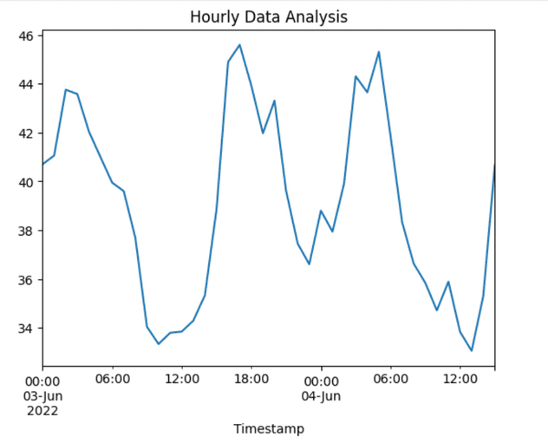
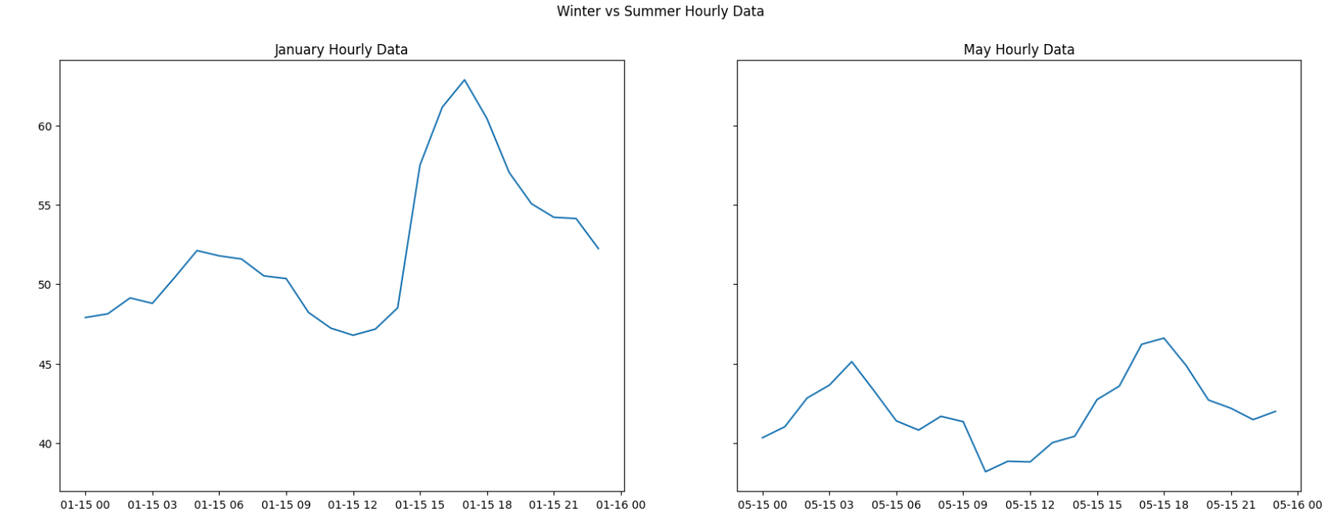
01/
Trends & Seasonality
Diurnal Trends
A triple-peak structure is apparent, with PM2.5 concentrations:
Surging around 3 A.M., forming a morning peak
Plummeting at noon, as the day wears on
Rising again till 6 P.M., before experiencing a second drop
Diurnal pattern suggests that targeted interventions, such as traffic management and emission controls, could be implemented during peak emission periods to reduce PM2.5 concentrations.
Seasonal Trends
A striking seasonal trend emerges, with winter months (January) plagued by alarmingly high PM2.5 values, far surpassing those of summer months (May). This stark contrast highlights the critical importance of seasonal factors in shaping PM2.5 concentrations.
Seasonal trend, meanwhile, highlights the need for adaptive strategies that account for changing weather patterns and atmospheric conditions throughout the year.

Slide 6
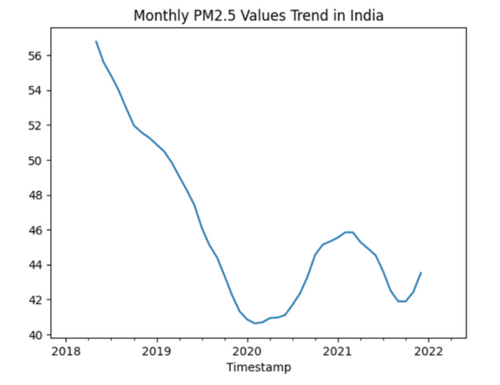
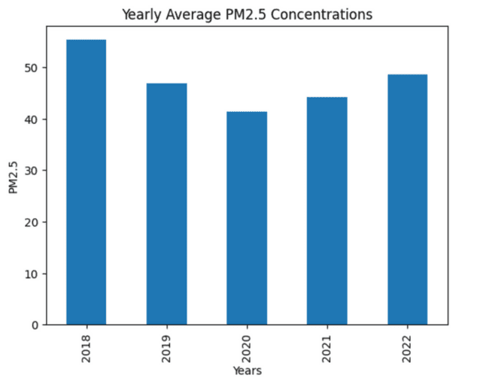
02/
COVID-19 Impact
The year 2020 witnessed a notable improvement in air quality and climatic conditions, with PM2.5 values plummeting to unprecedented lows.
However, this respite was short-lived, as the relaxation of lockdown measures in 2021 led to a reversal of this trend, with PM2.5 concentrations beginning to rise once again.
The COVID-19 pandemic brought the world to a standstill, but it also had an unexpected consequence - a significant reduction in PM2.5 concentrations.
This stark contrast highlights the critical role that human activities play in exacerbating air pollution and underscores the need for sustained efforts to mitigate climate change.
Analysis revealed the unexpected benefits of COVID-19 lockdowns on PM2.5 concentrations, showcasing a remarkable 25% reduction in PM2.5 Concentration Values during the pandemic, across India.
Significant positive impact of COVID-19 on PM2.5 concentrations and, thus, climate change can be attributed to the strict "self-isolation" regime and reduced mobility as well as industrial activities led to a shift towards natural patterns.

Slide 7

03/
Predictive Modelling
To gauge the effectiveness of our forecasting models, we generated sample predictions of SARIMA and Holt Winters on historical data, which were then compared against test values to evaluate their accuracy.
By doing so, we aimed to determine which model excels in capturing the underlying patterns and trends in the data, ultimately informing our decision on the most suitable approach for predicting future values.
However, here we see a large deviation from values starting March 2022. This can be attributed to the complete uplifting of the lockdowns and resuming of all normal activities.

Slide 8
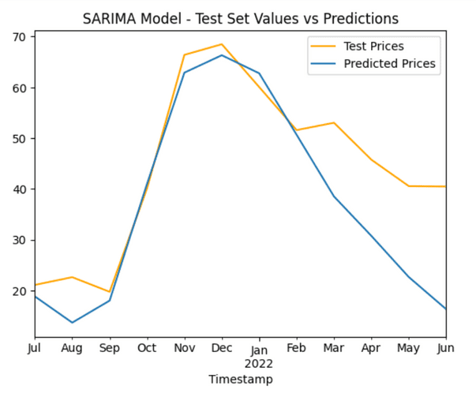

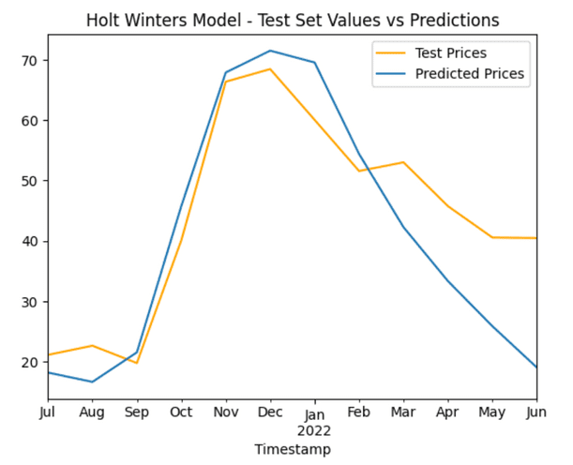

03/
Predictive Modelling
SARIMA MODEL
Pros:
Accurate Predictions: The model demonstrates a strong ability to predict PM2.5 values, with a high degree of accuracy.
Cons:
Inadaptability To Recent Surges: The model predictions would not take into account the last few months’ unusual surge in PM2.5 values and would ignore them as residuals.
Improvement:
HOLT WINTERS MODEL
Pros:
Accurate Predictions: The model demonstrates a strong ability to predict PM2.5 values, with a high degree of accuracy, better than that of the SARIMA Model.
Adaptability To Recent Surges: The model predictions would also takes into account the last few months’ surge in PM2.5 values and gives higher PM2.5 values as expected.
Cons:
Inability to Account for External Factors: The model's limitations highlight the importance of considering external factors and their potential impact on model performance.

Slide 9
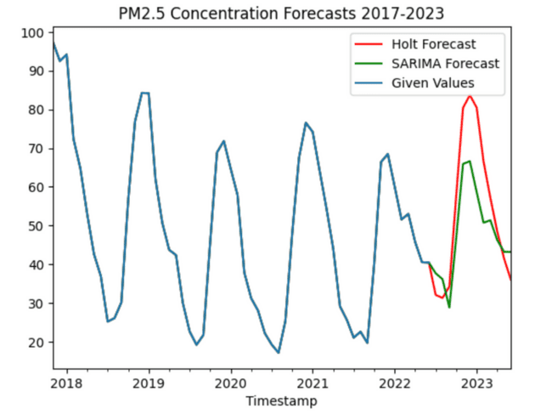
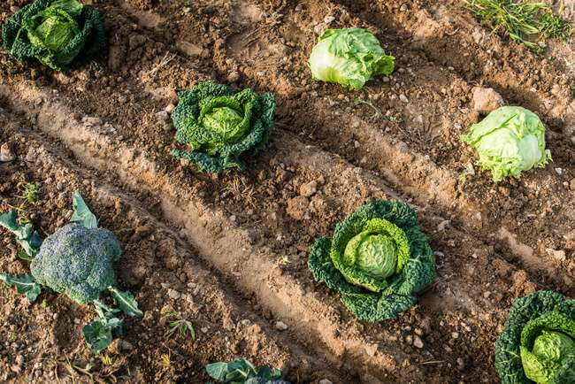
04/
Scope
1 Year Forecast using Sample Data
The project aims to develop a predictive model to forecast PM2.5 values using time series analysis. The scope includes:
Developing a SARIMA model to predict PM2.5 values
Identifying limitations of the SARIMA model
Implementing a Holt-Winters Model (Triple Exponential Smoothing) to improve forecasting accuracy
Fitting a sample model for test data set predictions
The goal is to create a reliable and accurate model that can forecast PM2.5 values, taking into account unexpected changes in external factors to the best of our capabilities.
However, it remains impossible to predict unexpected factors, like the COVID-19 pandemic affect. But we endeavor to come up with the most reliable solutions possible to be able to formulate policies and mitigate a large section of disasters and phenomenon like global warming, air pollution, respiratory diseases, etc.

Slide 10
05/
Impact on Climate Change
The project's impact on climate change is significant, as it utilizes PM2.5 values to analyze trends and understand future values, ultimately helping to tackle the problem of climate change. By predicting PM2.5 concentrations, the project can:
Inform Policy Decisions: Provide policymakers with accurate data to develop and implement effective climate change mitigation strategies.
Enhance Air Quality Management: Help optimize air quality management systems, reducing the negative impacts of PM2.5 on human health and the environment.
Support Sustainable Development: Contribute to sustainable development by promoting cleaner energy sources, reducing emissions, and protecting the environment.
By leveraging machine learning models, such as SARIMA and Holt-Winters, the project can accurately predict PM2.5 concentrations, ultimately helping to combat climate change and promote a healthier, more sustainable environment.
Attributions & References:
Kaggle Air Quality India Dataset: https://www.kaggle.com/datasets/fedesoriano/air-quality-data-in-india
ChatGPT OpenAI: For rephrasing and textual content

Slide 11
VIT University, Chennai
Thanks
Naysah Sheikh - 22BCE1943

